Slide 1
Credit Card Default Prediction
-Tonmoy Khanal

Slide 2
Problem Statement
Financial threats are displaying a trend about the credit risk of commercial banks as the
incredible improvement in the financial industry has arisen. In this way, one of the
The biggest threats faced by commercial banks is the risk prediction of credit clients.
The goal is to predict the probability of credit default based on credit card owner's
characteristics and payment history.

Slide 3
Problems to Resolve
Problem Statement
Purpose of Project
● ML applications focused on credit score predicting.
● Relying on credit scores and credit history.
● Miss valuable customers with no credit history. I.e. immigrants.
● Regulatory constraints on banking industry forbids some ML algorithms.
● Conduct quantitative analysis on credit default risk by applying three interpretable machine learning models without utilizing credit score or credit history.

Slide 4
Approach Overview
Data Cleaning
Data Exploration
Predictive Modelling
Understand and Clean
Data Exploration
Machine Learning
● Find information on undocumented columns values
● Clean data to get it ready for analysis
● Exam data with visualization
● Verify findings with statistical tests
● Logistic Regression
● Random Forest
● XGBoost

Slide 5
Part1- Exploratory Data Analysis
How does the probability of default payment vary by categories of different demographic variables?

Slide 6
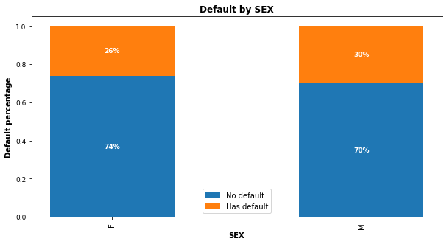
Gender variables
30% of males
and 26% of females have payment default.

Slide 7
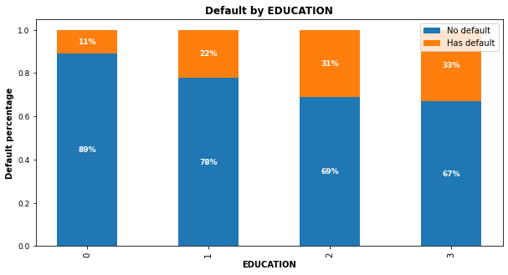
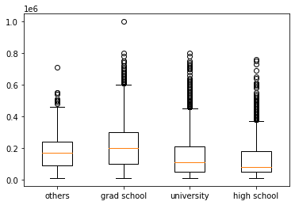
Education Variable
Higher education level, lower default risk.
Others” only consists 1.56% of total customers even if they appear to have the least default.

Slide 8
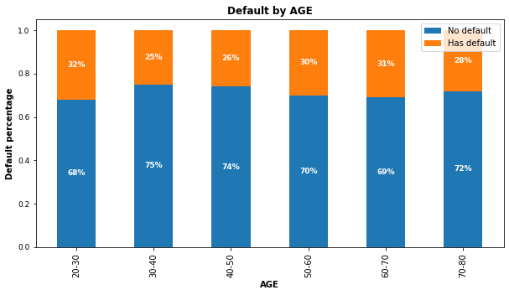
Age variable
30-50: Lowest risk
< 30 or >50: Risk increases

Slide 9
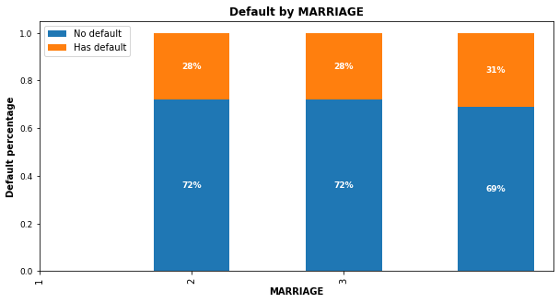
Marital Status Variable
No significant correlations of default risk and marital status

Slide 10
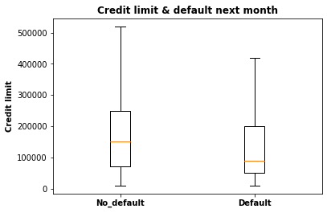
Credit Limit Variable
Higher credit limits,
lower default risk.

Slide 11
EDA Summary
● Demographic factors that impact default risk are:
○ Education: Higher education is associated with lower default risk.
○ Age: Customers aged 30-50 have the lowest default risk.
○ Sex: Females have lower default risk than males in this dataset.
○ Credit limit: Higher credit limit is associated with lower default risk.

Slide 12
Part 2-
Predictive Modelling
Which variables are the strongest predictors of default payment

Slide 13
Modelling Overview
Define Problem
Supervised learning / binary classification
Imbalanced Classes
78% non-default vs. 22% default
Tools Used
Scikit learn library and imblearn
Models applied
Logistic Regression / Random Forest / XGBoost

Slide 14
Modelling Steps
Data Preprocessing
Data Cleaning
Model Evaluation
● Feature selection
● Feature engineering
● Train-test data splitting (70%/30%)
● Training data rescaling
● SMOTE oversampling
● Start with default model parameters
● Hyperparameters tuning
● Measure ROC_AUC on training data
● Models testing
● Precision_Recall score
● Compare with sklearn dummy classifier
● Compare within the 3 models

Slide 15
Correct Imbalanced Classes
● Fit every model without and with SMOTE oversampling for comparison.
● Training AUC scores improved significantly with SMOTE.
Models | AUC Without SMOTE | AUC With SMOTE
Logistic Regression | 0.794684 | 0.794689
Random Forest | 0.903371 | 0.903748
XGBoost | 0.860241 | 0.860476

Slide 16
Hyperparameters Tuning
● K-Fold Cross Validation to get average performance on the folds.
● Randomized Search on Logistic Regression since C has large search space.
● Grid Search on Random Forest on limited parameters combinations.
● Randomized Search on XGBoost because multiple hyperparameters to tune.

Slide 17
Model Comparisons
● Compare the models to Scikit-learn’s dummy classifier.
● All models performed better than dummy model.
Models | Precision | Recall | F1 Score | Conclusion
Dummy Model | 0.501 | 0.501 | 0.501 | Benchmark
Logistic Regression | 0.729 | 0.714 | 0.721 | Good
Random Forest | 0.841 | 0.812 | 0.826 | Best F1
XGBoost | 0.862 | 0.832 | 0.847

Slide 18
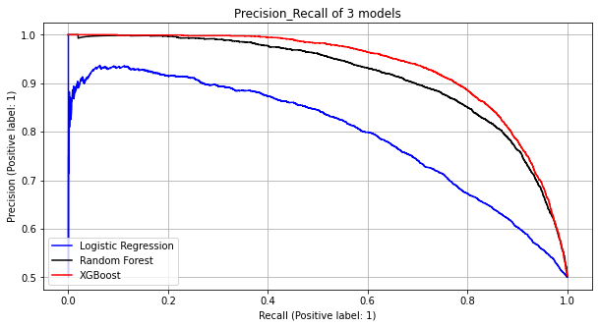
Model Comparisons
● Compare within 3 models.
● Random Forest (black line) has the best precision_recall score.
Terminology:
★ Recall: how many 1s are being identified?
★ Precision: Among all the 1s that are flagged, how many are truly 1s?
★ Precision and recall trade-off: high recall will cause low precision

Slide 19
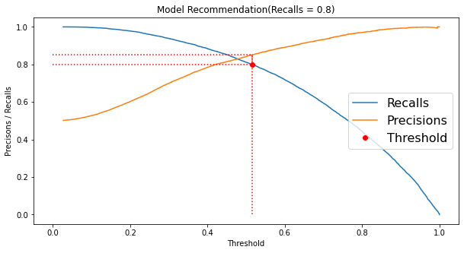
Model Usage - Recommendation 20
● I.e. recall = 0.8. Threshold can be adjusted to reach higher recall.

Slide 20
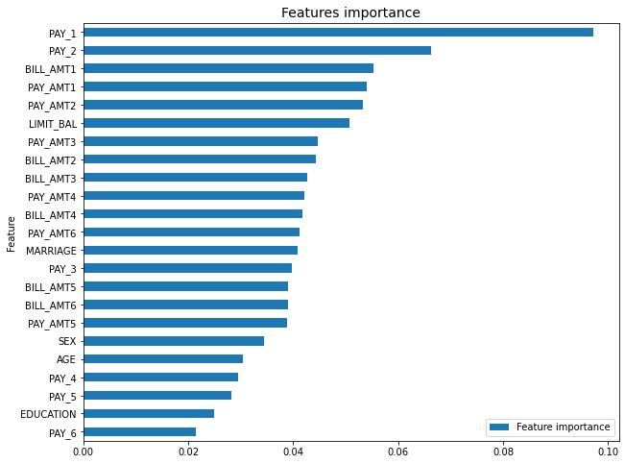
Feature Importance
Best model Random Forest feature importance plot.
★ PAY_1: most recent month’s payment status.
★ PAY_2: the month prior to current month’s payment status. ★ BILL_AMT1: most recent month’s bill amount.
★ LIMIT_BAL: credit limit

Slide 21
Limitations & Future Work
● Best model Random Forest can only detect 51% of default.
● Model can only be served as an aid in decision making instead of replacing human decision.
● Used only 30,000 records and not from US consumers.
● Models are not exhaustive. Other models could perform better.
● Get more computational resources to tune XGBoost parameters.
● Acquire US customer data and more useful features.
i.e. customer income
Limitations
Future Work

Slide 22
Conclusions
● Recent 2 payment status and credit limit are the strongest default predictors.
● Dormant customers can also have default risk.
● Random Forest has the best precision and recall balance.
● Higher recall can be achieved if low precision is acceptable.
● Model can be served as an aid to human decision.
● Suggest output probabilities rather than predictions.
● Model can be improved with more data and computational resources.

Slide 23



https://www.linkedin.com/in/tonmoy-khanal-5573931b2/
Thank You
https://www.linkedin.com/in/tonmoy-khanal-5573931b2/
https://github.com/tonmoy-khanal
http://www.tonmoykhanal.tech

